Slide 1
The State of IWLP in UKHE: Institution-wide language provision in the changing landscape
Dr John Morley
The University of Manchester

Slide 2
1. Survey of institutions aimed to:
gauge availability and demand for different IWLP languages in UKHE and note changing trends
ascertain the proportion of and arrangements for credit and non-credit provision
determine the numbers of international students taking IWLP languages, and what challenges/opportunities this presence brings;
gauge respondents’ views on prospects for IWLP
2. Survey of students aimed to:
obtain a snapshot of their profiles and motivations

Slide 3
Institutional Survey: Method
Simple electronic questionnaire emailed to AULC and UCML distribution lists
data collected from 65 HEIs in the UK, 23 of which were Russell Group universities (24)
Respondents: mainly Directors/Coordinators in Language Centres/Units; some Heads of Faculty/Department; five responses from administrators

Slide 4
Proportion of credit and non-credit students
Approx. 60% of IWLP students are studying for academic credit.
At some intuitions for-credit study is not an option
At some institutions not-for-credit study is not an option
In most cases (55%), credit and non-credit students are taught side by side

Slide 5
Main languages studied showing numbers reported

Slide 6
Growth areas
 | Marshall, 2001 |  | AULC/UCML, 2012 |  | AULC/UCML, 2013
 | % of students | % of HEIs | % of students | % of HEIs | % of students | % of HEIs
Chinese | 0.7% | 16%
BSL | - | -
Korean | - | -

Slide 7
Growth areas
 | Marshall, 2001 |  | AULC/UCML, 2012 |  | AULC/UCML, 2013
 | % of students | % of HEIs | % of students | % of HEIs | % of students | % of HEIs
Chinese | 0.7% | 16% | 8% | 78.7%
BSL | - | -
Korean | - | -

Slide 8
Growth areas
 | Marshall, 2001 |  | AULC/UCML, 2012 |  | AULC/UCML, 2013
 | % of students | % of HEIs | % of students | % of HEIs | % of students | % of HEIs
Chinese | 0.7% | 16% | 8% | 78.7% | 8.5% | 88%
BSL | - | -
Korean | - | -

Slide 9
Growth areas
 | Marshall, 2001 |  | AULC/UCML, 2012 |  | AULC/UCML, 2013
 | % of students | % of HEIs | % of students | % of HEIs | % of students | % of HEIs
Chinese | 0.7% | 16% | 8% | 78.7% | 8.5% | 88%
BSL | - | - | 0.39% | 7% | 1% | 20%
Korean | - | -

Slide 10
Growth areas
 | Marshall, 2001 |  | AULC/UCML, 2012 |  | AULC/UCML, 2013
 | % of students | % of HEIs | % of students | % of HEIs | % of students | % of HEIs
Chinese | 0.7% | 16% | 8% | 78.7% | 8.5% | 88%
BSL | - | - | 0.39% | 7% | 1% | 20%
Korean | - | - | 0.53% | 10% | 0.7% | 16%

Slide 11
Overall numbers reported in the survey
UCML/AULC 2012: 49,637 (62)
UCML/AULC 2013: 54,537 (65)

Slide 12
Numbers compared to previous academic year

Slide 13
The five languages most reported as showing an increase compared to last year

Slide 14
The five languages most reported as showing a decrease compared to last year

Slide 15
International students
IWLP appears to attract a high proportion of international students (EU and non-EU)
The mean of all the % figures that were given: 38% (10% - 85%)

Slide 16
Opportunities, issues, challenges

Slide 17
Standardisation and Accreditation
Do you make use of a common set of externally referenced proficiency descriptors?
Total | 65
Yes, we make use of the CEF | 85% (55)
Yes, we make use of another system | 14% (9)
No, we don't have a system | 2% (1)

Slide 18
Standardisation and Accreditation
Do you think a standardised self-evaluation scheme would be useful?
Total | 61
Yes | 64% (39)
No | 5% (3)
Not sure | 31% (19)

Slide 19
Standardisation and Accreditation
Do you think a national accreditation scheme for language centres would be useful?
Total | 61
Yes | 44% (27)
No | 12% (7)
Not sure | 44% (27)

Slide 20
A quality assurance scheme should require that

Slide 21
Additional criteria
Student representatives for languages
Standardised contact hours
Standardised content/assessments

Slide 22
Additional criteria
Student representatives for languages
Standardised contact hours
Standardised content/assessments
Comments
Should not be too prescriptive/bureaucratic
Would serve better as a point of reference
Concerns about cost/operational implications

Slide 23
Module/course unit restrictions
Is recruitment of students on to your courses affected by course unit/module level restrictions determined elsewhere in your institution?
Total | 59
Yes | 73% (43)
No | 27% (16)

Slide 24
ways of circumventing course unit/ module level restrictions

Slide 25
Institutional strategies and/or policies for IWLP
Does your institution have a strategy and/or policy for institution-wide language learning?
Total | 54
Yes | 56% (30)
Yes, but … | 13% (7)
No, but … | 4% (2)
No | 28% (15)

Slide 26
Institutional strategies and/or policies for IWLP
“Yes – this is linked to the university’s internationalisation and employability strategies, and involves the provision of a free language course for all undergraduates.”
“the IWLP features as an important element of the University’s Internationalisation and Employability strategies and is supported at senior management level”
“This is seen as part of our L&T, Employability and Internationalisation strategies“

Slide 27
Prospects for Institution-wide Language Provision

Slide 28
Reasons for uncertainty
“Competition of options on courses (protectionism). Decreasing interest in language learning on the part of UK students.”
“Programmes are increasingly discouraging language study, so as to maximise income from student fees to their own programmes.”

Slide 29
Reasons for being optimistic
“Our new V-C sees the international agenda of the institution as a high priority. He himself comes from MFL.”
“Total support from the University Senior Management Group, of which I am a member.”
“Insatiable demand for language learning, high quality courses with high rates of continuity, support from colleges for flagship programme.“
“Continuous increase in student numbers, students voting with their feet to join a language class, strong support for languages from the University Executive, internationalisation agenda”

Slide 30
Reasons for being optimistic
“Our new V-C sees the international agenda of the institution as a high priority. He himself comes from MFL.”
“Total support from the University Senior Management Group, of which I am a member.”
“Insatiable demand for language learning, high quality courses with high rates of continuity, support from colleges for flagship programme.“
“Continuous increase in student numbers, students voting with their feet to join a language class, strong support for languages from the University Executive, internationalisation agenda”

Slide 31
Conclusions
Overall picture on sector is broadly positive
Large proportion of international students; largely beneficial
Broad evidence for institutional support
General consensus on the usefulness of a standards framework for reference.
Need for continual collection and sharing of data

Slide 32
Student Survey
Profile: level of study, discipline, mode of study
Motivations
Importance of languages

Slide 33
1211 responses
Cambridge University | 166 | 14%
Coventry University | 118 | 10%
The London School of Economics | 150 | 12%
The University of Birmingham | 118 | 10%
The University of Leeds | 142 | 12%
The University of Manchester | 276 | 23%
The University of Sheffield | 193 | 16%
The University of Warwick | 42 | 3%

Slide 34
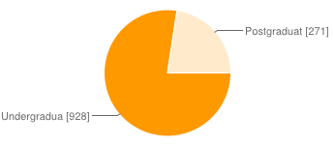
Are you an undergraduate or a postgraduate?

Slide 35
Social Sciences (e.g. Economics, Sociology, Anthrop) | 193 | 16%
Engineering | 180 | 15%
Modern Languages, Linguistics | 148 | 12%
Humanities (e.g. English, History, Philosophy) | 135 | 11%
Business and Management | 115 | 10%
Physical Sciences (e.g. Chemistry, Geology, Physics) | 94 | 8%
Biological Sciences | 64 | 5%
Mathematics | 45 | 4%
Arts (e.g. Drama, Music, Art, Fashion) | 42 | 3%
Law | 37 | 3%
Health (e.g. Medicine, Dentistry, Nursing, Pharmacy) | 31 | 3%
Computer Science | 23 | 2%
Psychological Sciences | 20 | 2%
Other | 75 | 6%

Slide 36
French | 280 | 23%
Spanish | 231 | 19%
German | 224 | 19%
Italian | 155 | 13%
Japanese | 86 | 7%
Chinese | 85 | 7% (9%)
Arabic | 35 | 3% (6%)
BSL | 24 | 2%
Russian | 24 | 2%
Portuguese | 13 | 1%
Korean | 9 | 1%
Other | 22 | 2%

Slide 37
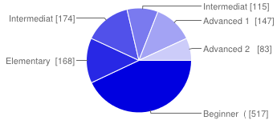
Which description below best fits the level you are studying?

Slide 38
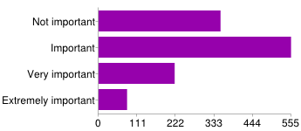
For holiday purposes

Slide 39
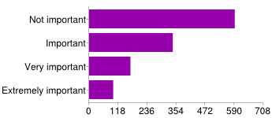
To gain good marks

Slide 40
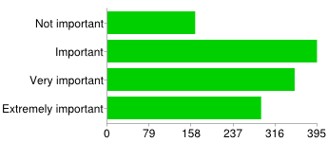
To engage globally more effectively

Slide 41
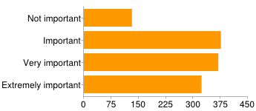
To enhance my employment prospects

Slide 42
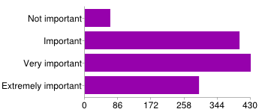
To broaden my mind

Slide 43
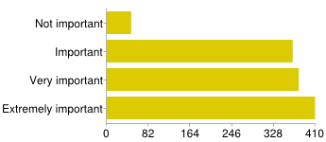
I enjoy learning this language

Slide 44
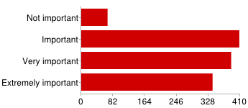
How important is it for you to develop: the writing skill

Slide 45
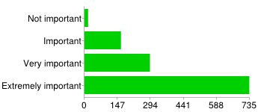
How important is it for you to develop: the speaking skill

Slide 46
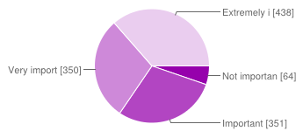
How important is it for you to be able to study a language whilst you are at university?

Slide 47
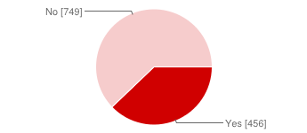
Was the opportunity to learn a language a factor in your choice of university?

Slide 48
REFERENCES
Byrne, N. and Abbot, J. (2007) Survey on university students choosing a language course as an extra-curricular activity. Results from the second year of a planned three-year survey conducted by AULC on behalf of the DIUS. November. Unpublished. Presentation based on this survey is available here: http://www.celelc.org/docs/byrne_new_multisubject_programmes_0.pdf (accessed on 7th January 2013)
Marshall, K. (2001) Survey of less specialist language learning in UK universities (1998-99) http://www.llas.ac.uk/resourcedownloads/614/KeithMarshall.pdf (accessed on 7th January 2013)
UCAS (2012) Applicants preferred subject choice and accepted applicants subject of acceptance (for 2011). http://www.ucas.com/about_us/stat_services/stats_online/data_tables/hesubject (accessed on 7th January 2013)

